Slide 1

Khulna University of Engineering & Technology
Prepared by
Group - 55
Sk. Azraf Sami
Dept. of CSE
Roll: 1907115
Prottoy Roy
Dept. of CSE
Roll: 1907025
‹#›

Slide 2
Demonstrate the operation of RC phase shift audio oscillator

Slide 3
Objectives
TO demonstrate the RC-phase shift oscillator.
TO gain knowledge about the basic construction and working principle of RC-phase shift oscillator.
To analyze and design RC-phase shift oscillator.
To get idea about feedback oscillator.
To know about the applications of it.
Your audience will listen to you or read the content, but won’t do both.
‹#›

Slide 4
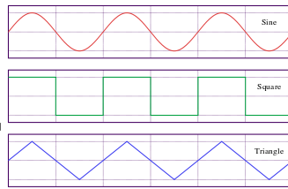
Introduction
Oscillator :
An electronic oscillator is an electronic circuit that converts electrical energy from DC power supply to periodic waveform.
DC Power supply
Oscillator circuit
RC Phase Shift Oscillator :
An RC phase shift oscillator is one of many AC oscillator circuits that is adaptable to a wide range of loads.
Feedback Network
Oscillator Circuit
Amplifier
‹#›

Slide 5
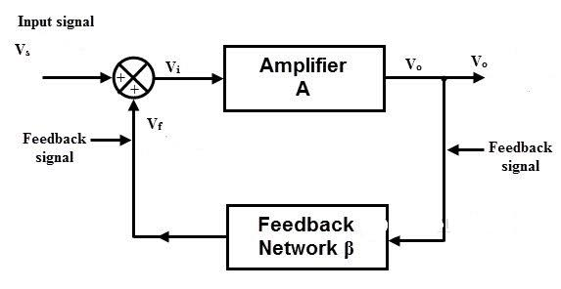
Introduction
Feedback Oscillator :
A type of oscillator that returns function of the output signal to the input with no net phase shift resulting in a reinforcement of the output signal.
‹#›

Slide 6
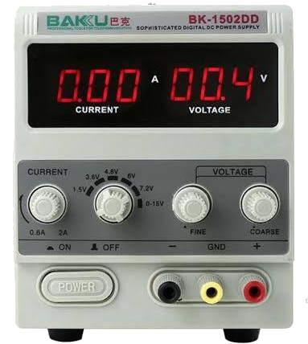
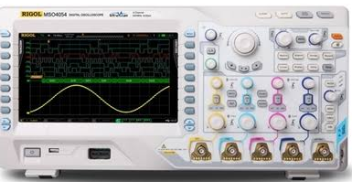
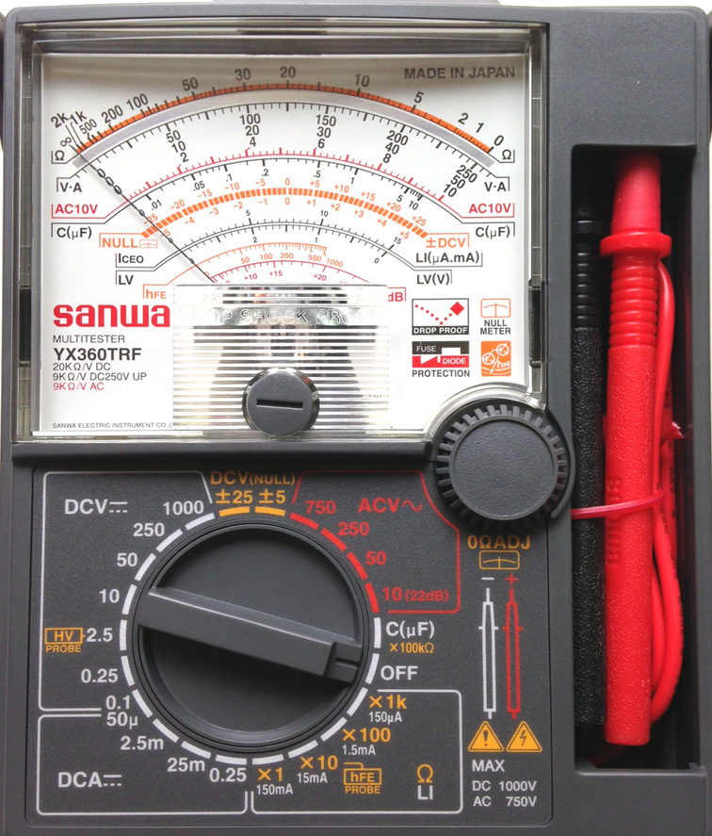
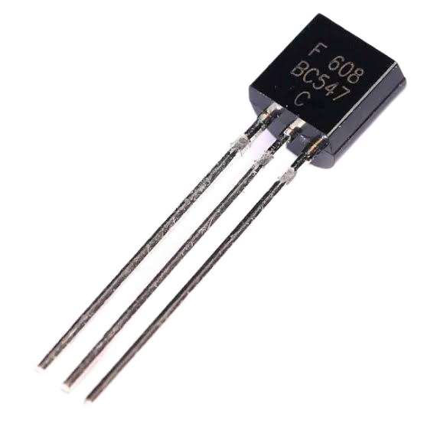
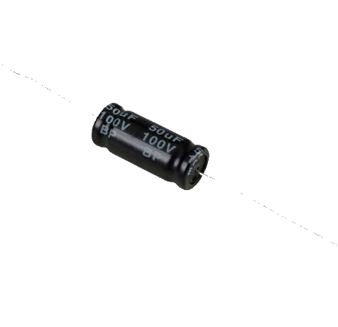
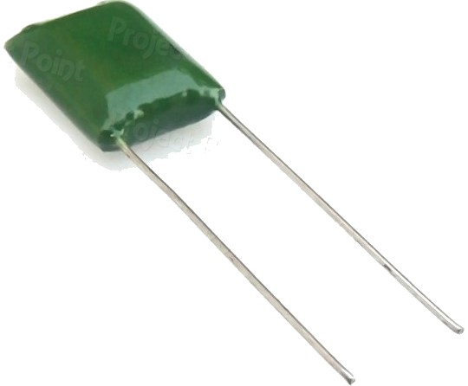
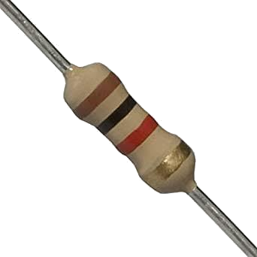
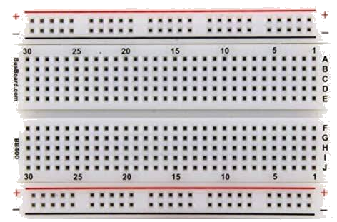
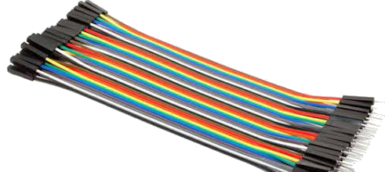
APPARATUS:
DC Power Supply
Oscilloscope
Multimeter
Transistor (BC 547)
50 µF + 10 µF + 0.0224 µF Capacitors
1 Kohm X 3 + 150 kohm + 270 ohm + 6.8 kohm + 2.2kohm resistors
Breadboard
Connecting Wire
‹#›

Slide 7
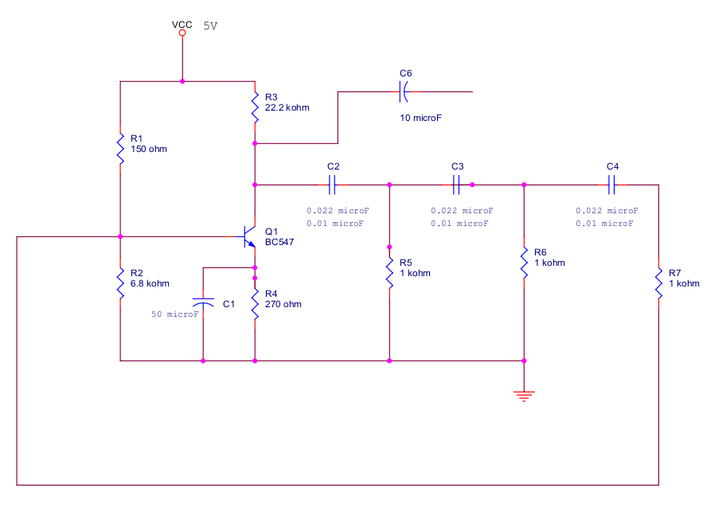
Experimental Setup
+
360 degrees
Output
Amplifier
Oscillator
60
60
60
Voltage divider
180 degrees
180 degrees
‹#›

Slide 8
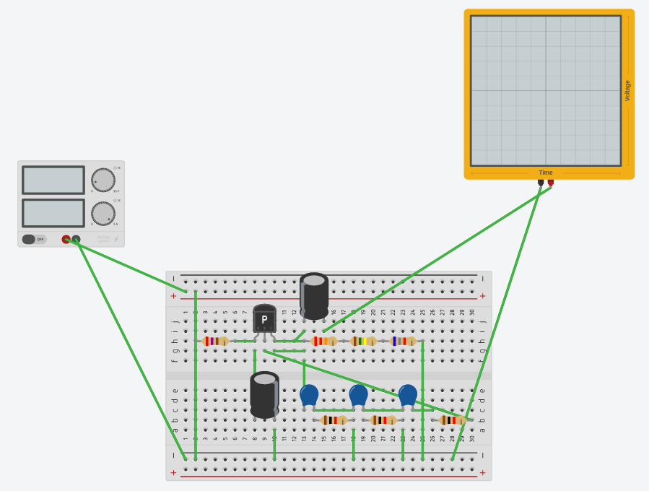
Implementation on breadboad
‹#›

Slide 9
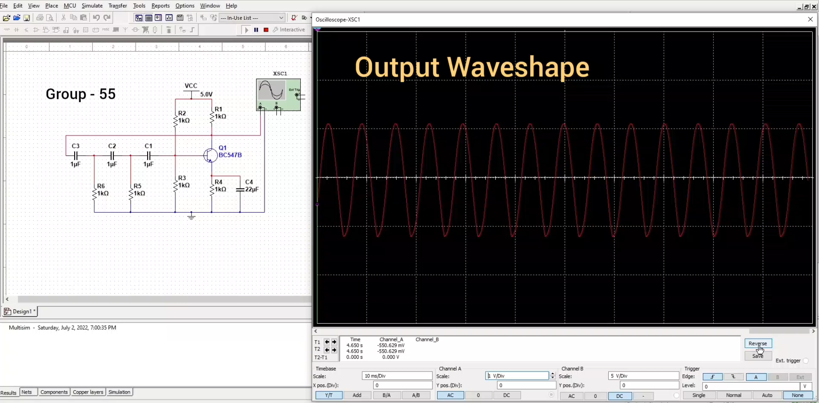
Circuit Simulation
‹#›

Slide 10
??
Why do we need three RC networks for a phase shift oscillator? Can’t be two or four?
The theoretical maximum phase shift you can get with an RC network is 90 degrees, but I need 180 degrees phase shift..
So, you need at least two of them, but in practice the loop gain would be zero with such a system so nothing would be happen.
Three stages, each shifting 60 degrees, is usually enough. You can have four or more, but there is no advantages.
‹#›

Slide 11
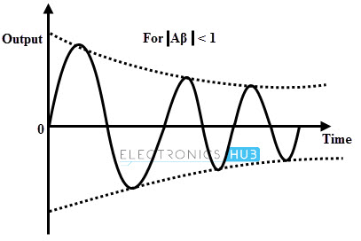
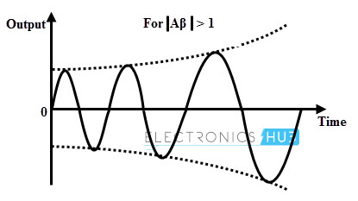
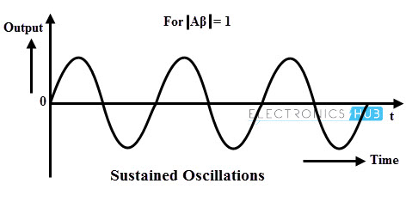
??
In RC phase shift oscillator, amplifier circuit is used, but why is the output not amplified (magnitude)?
It mainly depends on the modulus of Aβ,
where, A = voltage gain without feedback
and β = feedback factor
|Aβ| < 1
|Aβ| > 1
|Aβ| = 1
Exponentially-Decaying-Oscillations
Growing-Type-of-Oscillations
Sustained-Oscillations
‹#›

Slide 12

Experimental Data
From Circuit:
Vc = 2.0 V
VB = 1.2 V
VE = 0.8 V
Phase Shift:
For ‘A’ point = 64 degrees
For ‘B’ point = 127 degrees
For ‘C’ point = 176 degrees
‹#›

Slide 13
Conclusion
The practical circuit of RC phase shift oscillator was successfully conducted.
It had generated a sine wave of frequency Fc=2.745 kHz, with an amplitude of 500 mV X 4.75 = 2.375 V.
The error percentage is 7.04%.
‹#›

Slide 14
APPLICATIONS
RC phase shift oscillators is used to generate the signals over an extensive range of frequency.
They used in :
Musical Instrumnets.
GPS Units.
Voice Synthesis
‹#›

Slide 15
thanks!
Special thanks to :
Abu Sayeed Md. Jannatul Islam Sir
Assistant professor
Dept. of EEE, KUET
Khadijatul Kubra Mam
Lecturer
Dept. of EEE, KUET
‹#›

